Slide 1

Sanskrithi School of Engineering Puttaparthi DEPARTMENT OF ELECTRONICS & COMMUNICATION ENGINEERING
Project Final Review Meeting
Intelligent Parking With Arduino & Bluetooth Control
Date: 24-04-2025

Slide 2
Intelligent Parking With Arduino & Bluetooth Control
BATCH NUMBER : 10
YEAR & SEM : IV Year & II Semester
1. 21KF1A0446 – P.RANI
2. 21KF1A0443 – O.SHAMSHAD 3. 21KF1A0412 – D.R.SAMATHA 4. 22KF5A0402 – K.BHAVITHA
Under The Guidance
Of
Mr. Rakesh Yadav Kodari

Slide 3
TABLE OF CONTENTS
Plan of Action
Abstract
Literature Survey
Existing System
Components
Block Diagram
Flow Chart
Implementation
Conclusion

Slide 4
Plan of Action
S.No | Month and Week | Description
1 | January 1st & 2nd week | Topic Finalization
2 | January 3rd week | Literature Review related to our title.
3 | January 4th Week | Finalise the proposed work based on literature survey
4 | February 1st Week | Awaiting approval from the supervisor for proposed work and methodologies
5 | February 2nd & 3rd Week | Working under existing system to check the experimental results
6 | February 4th Week & March 1st Week | Programming related to proposed system
7 | March 2nd Week | Execution of proposed system Level-1
8 | March 3rd & 4th Week | Execution of proposed system Level-2
9 | April 1st Week | Final Experimental Results
10 | April 2nd and 3rd Week | Report making and participation in Conference
11 | April 4th Week | Planning of Journal Publication

Slide 5
Abstract
This project implements a Bluetooth-controlled car using an Arduino microcontroller, allowing wireless operation through an app. The system consists of a robot platform equipped with two DC motors, four wheels, and a motor driver for precise movement control. A Bluetooth module enables seamless communication between the car and the mobile app, allowing users to send movement commands remotely. The 12V battery powers the system efficiently, with a slide switch for easy operation. By providing a responsive and user-friendly control mechanism, this project offers an interactive and practical solution for wireless robotic vehicle navigation

Slide 6
Introduction
In recent years, wireless technology has revolutionized the way we interact with electronic devices, enabling greater convenience and control. One such application is the development of Bluetooth-controlled robotic vehicles, which offer a flexible and efficient alternative to traditional remote-controlled systems. This project focuses on implementing a Bluetooth-controlled car using an Arduino microcontroller, allowing users to operate the vehicle wirelessly through a mobile app. By integrating a motor driver, DC motors, and a Bluetooth module, the system ensures smooth and precise movement. A 12V battery powers the entire setup, providing stable operation, while a slide switch allows for easy activation. Designed for both practicality and user engagement, this project demonstrates an effective approach to wireless robotic navigation, making it suitable for educational, industrial, and hobbyist applications.

Slide 7
Literature Survey
Sl. No. | Title of the Paper | Author | Published | Description
1. | Design of Smart Car Control System for Gesture Recognition Based on Arduino | Zhexiang Zou, Qinyu Wu, Yuhang Zhang, Kaiyuan Wen | 2021 IEEE International Conference on Consumer Electronics and Computer Engineering (ICCECE) | presents a system where hand gestures are used to control a smart car. The setup involves an Arduino microcontroller, accelerometer sensors to detect gesture movements, and a Bluetooth module to transmit commands to the car. The paper discusses system architecture, circuit design, and gesture mapping for motion control. This approach aims to offer an intuitive, touchless way to operate small robotic vehicles.

Slide 8
Literature survey Contd…
Sl. No. | Title of the Paper | Author | Published | Description
2. | Des​ign and Implementation of a Bluetooth Remote Controlled Car Using PIC Microcontroller" | A.Smit, B.Johnson, C.Lee | IEEE Transactions on Vehicular Technology, 2023 | This paper details the development of a Bluetooth-controlled car using a PIC microcontroller, focusing on system architecture, communication protocols, and performance evaluation.

Slide 9
Literature survey Contd…
Sl. No. | Title of the Paper | Author | Published | Description
3. | "Dev​elopment of a Smartphone-Controlled Car Using Bluetooth and AVR Microcontroller" | D.Kumar, E.Wang | IEEE International Conference on Embedded Systems, 2022 | The authors present a design for a car controlled via smart phone using Bluetooth communication with an AVR microcontroller, including hardware design and software implementation.

Slide 10
Literature survey Contd…
Sl. No. | Title of the Paper | Author | Published | Description
4. | "Wir​eless Control of an Electric Vehicle Using Bluetooth and MSP430 Microcontroller" | F.Hernandez, G.Patel | IEEE Symposium on Wireless Systems, 2021 | This study explores the wireless control of an electric vehicle using Bluetooth technology integrated with an MSP430 microcontroller, emphasizing energy efficiency and control responsiveness.

Slide 11
Literature survey Contd…
Sl. No. | Title of the Paper | Author | Published | Description
5. | "Des​ign and Implementation of a Bluetooth-Based Home Automation System" | M. A. Rahman, S. Islam | IEEE International Conference on Electrical and Computer Engineering, 2023 | This paper presents the development of a home automation system controlled via Bluetooth. The prototype was assembled on a breadboard during the initial testing phase before finalizing the PCB design.​

Slide 12
Literature survey Contd…
Sl. No. | Title of the Paper | Author | Published | Description
6. | "Blu​etooth-Controlled Mobile Robot for Surveillance Applications" | L. Chen, R. Gupta | IEEE International Conference on Robotics and Automation, 2022 | The authors describe a mobile robot controlled through Bluetooth communication. The prototype's circuitry was first developed on a breadboard to validate the design before creating a more permanent setup.​

Slide 13
Literature survey Contd…
Sl. No. | Title of the Paper | Author | Published | Description
7. | "Dev​elopment of a Bluetooth-Enabled Wearable Health Monitoring Device" | K. Patel, D. Nguyen | IEEE Transactions on Biomedical Circuits and Systems, 2021 | This study details the creation of a wearable health monitoring device with Bluetooth connectivity. Initial prototypes were constructed using breadboards to test functionality and performance.

Slide 14
Existing System
Arduino receives commands from the Bluetooth-enabled device and performs a switch case operation. For example, if the user presses the "Forward" key on their phone, the Arduino will make IN1 and IN3 high and IN2 and IN4 low to move the car forward. The Arduino can also be used to control other things, such as home lighting and air conditioners, through a cell phone.
Disadvantages:
Bluetooth can lose connection in certain conditions.
Bluetooth has a short range of communication between devices.
Bluetooth can be hacked.
Using Bluetooth with an Arduino-based robotic arm can put a lot of pressure on the microcontroller.

Slide 15
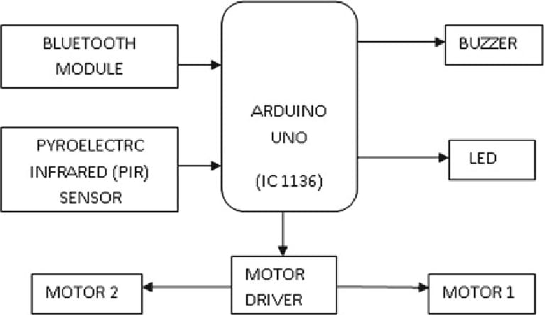
Block Diagram (Existing System)

Slide 16
Proposed System
This project introduces a Bluetooth-controlled car using an Arduino microcontroller, which enhances wireless communication and control. By integrating a Bluetooth module, the car can receive movement commands from a mobile app, eliminating the need for RF-based controllers. The system includes a motor driver for smooth movement and a 12V battery for stable power supply. With a simple and efficient control mechanism, this method improves user convenience, extends operational range, and provides a cost-effective solution for robotic vehicle navigation.
Advantages:
We can use any device with Android, such as a phone, tablet, or computer, as the remote.
Bluetooth provides a wide range of control.
Bluetooth is an efficient way to control the car.

Slide 17
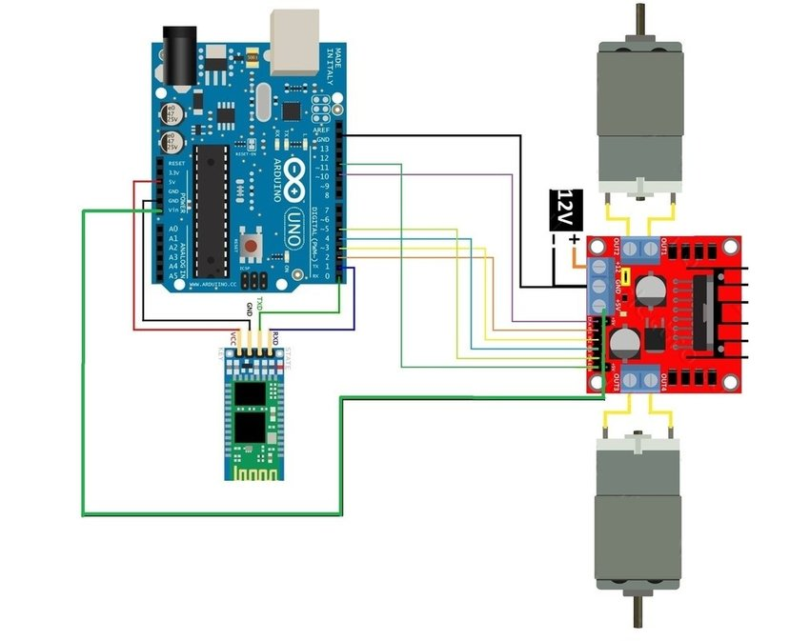
Block Diagram (Proposed System)

Slide 18
Components
Chassis Kit
Arduino Uno
Bluetooth HC05 module
Motor driver
DC Motor

Slide 19
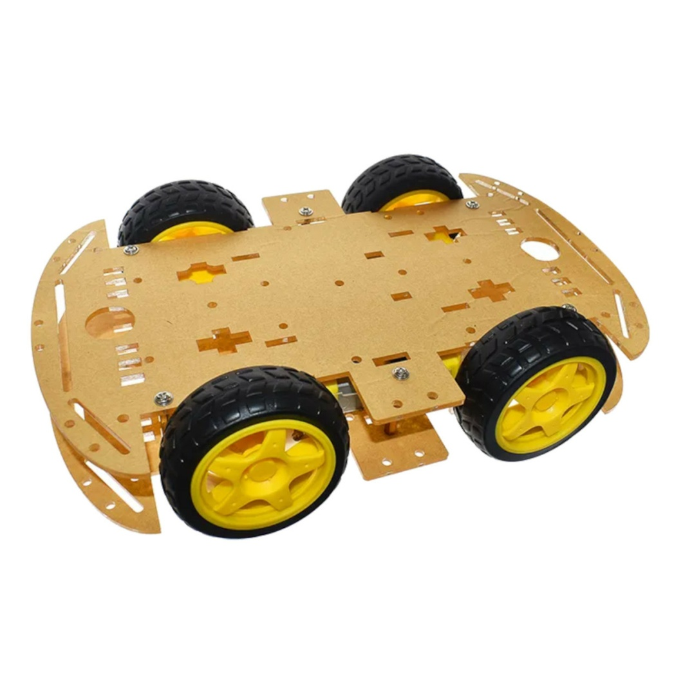
Chassis kit
Function: Base structure of the car.
Role: Holds all components together.

Slide 20
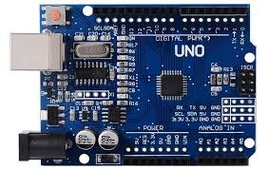
Arduino Uno
Function: Acts as the brain of the project.
Role: Reads Bluetooth commands and controls the motors accordingly

Slide 21
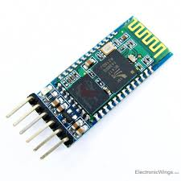
HC-05Bluetooth Module
*
Function: Enables wireless communication between your smart phone and the Arduino.
Role: Receives commands from an Android app

Slide 22
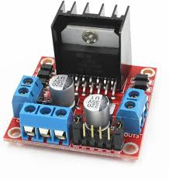
Motor Driver
.
Function: Drives the DC motors.
Role: Controls the direction and speed of the motors based on signals from the Arduino.

Slide 23
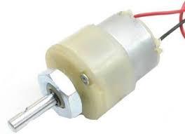
DC Motor
Function: Provide movement.
Role: Drive the wheels of the car forward, backward, left, and right.

Slide 24
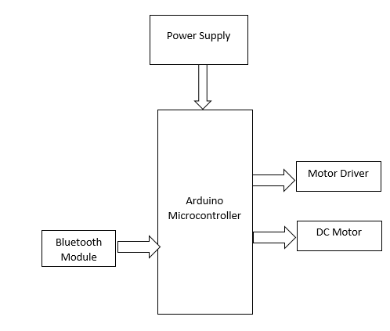
Block Diagram

Slide 25
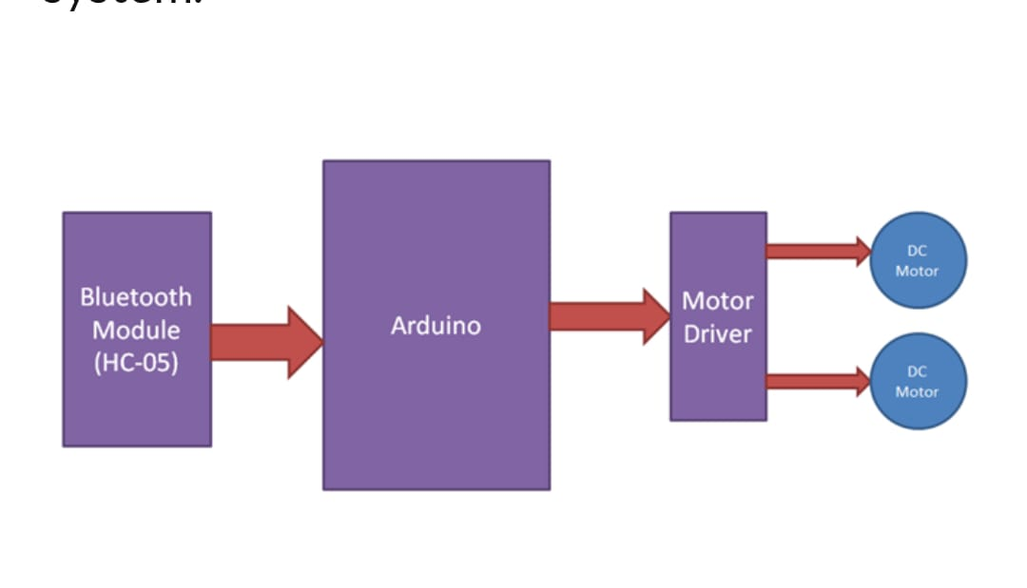
Flow Chart

Slide 26
Implementation
Step 1 : Assemble the Chassis and Motor
Step 2 : Set up the Arduino and motor shield
Step 3 : Connect the Motors
Step 4 : Establish Bluetooth Module Connections
Step 5 : Circuit connections of Arduino and Bluetooth
Step 6 : Connections of motor shield and the motor
Step 7 : Connect the batteries to the motor shields
Step 8 : Arduino code is inserted to the Arduino Uno
Step 9 : Bluetooth installation through the mobile
Step 10: Connect the Bluetooth and control the car using the buttons

Slide 27
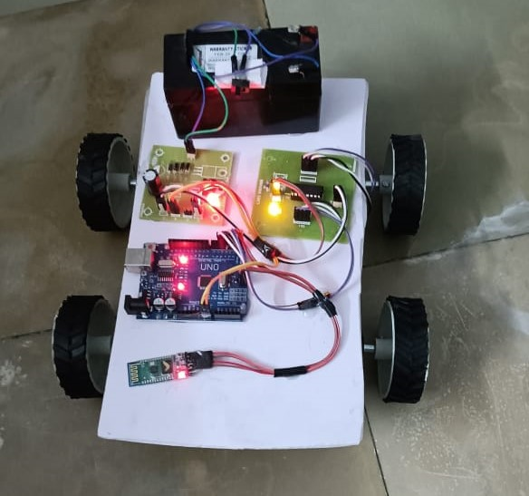
OUT PUT

Slide 28
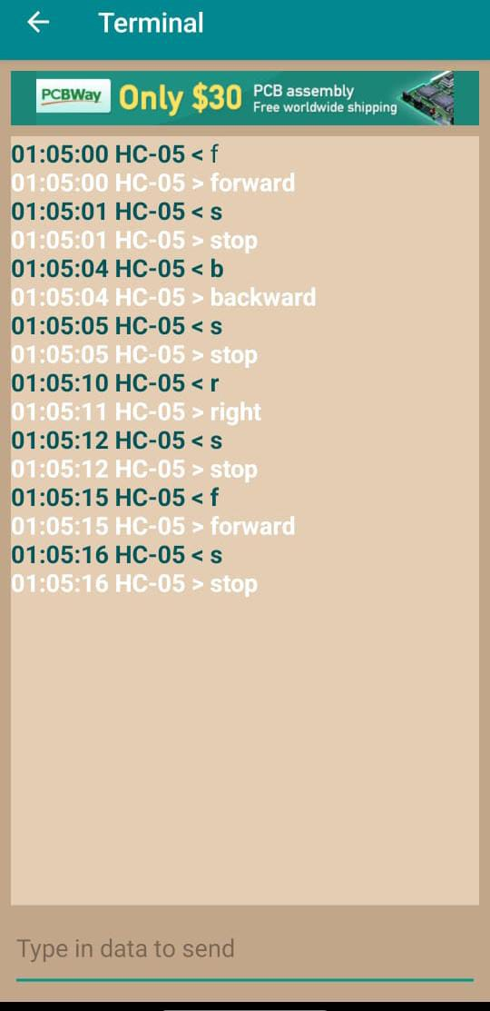
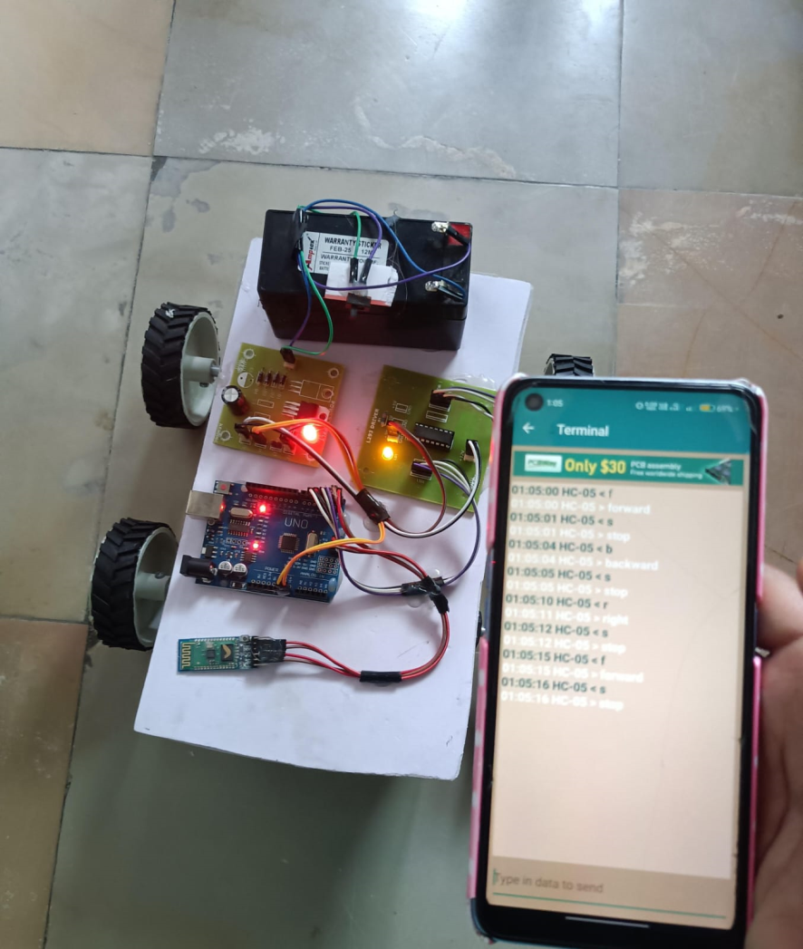
OUTPUT

Slide 29
Over all functional results
Project | Response time | Accuracy
Technical parameter | < 1 millisecond | 0.1–0.3 seconds

Slide 30
Conclusion
The Bluetooth-controlled car project successfully demonstrates the integration of wireless communication with embedded systems to achieve remote vehicle navigation. By using an Arduino microcontroller, HC-05 Bluetooth module, and L298N motor driver, the system allows seamless control through a smartphone app. The project not only showcases practical applications of robotics and automation but also offers a strong foundation for future advancements such as obstacle avoidance, GPS tracking, or voice control..

Slide 31
Future Scope
Future improvements can include adding obstacle detection using sensors, voice or gesture control, GPS tracking, and real-time video streaming. Speed control via PWM and a rechargeable battery system with solar charging can further enhance efficiency and functionality.

Slide 32
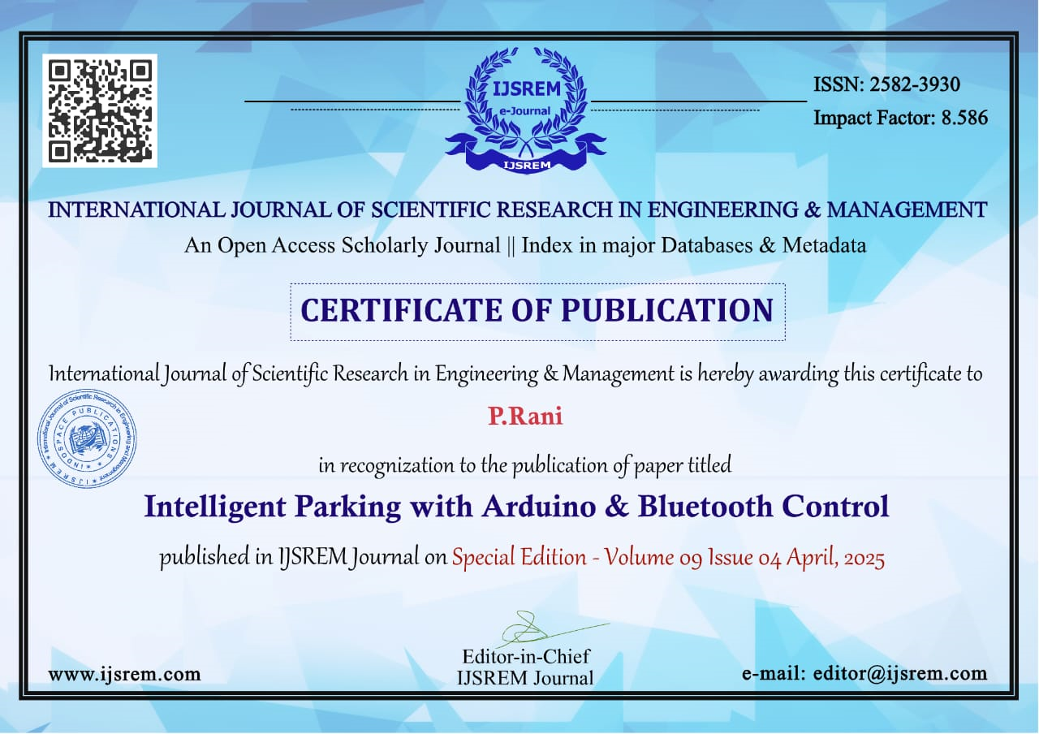
Certificates

Slide 33
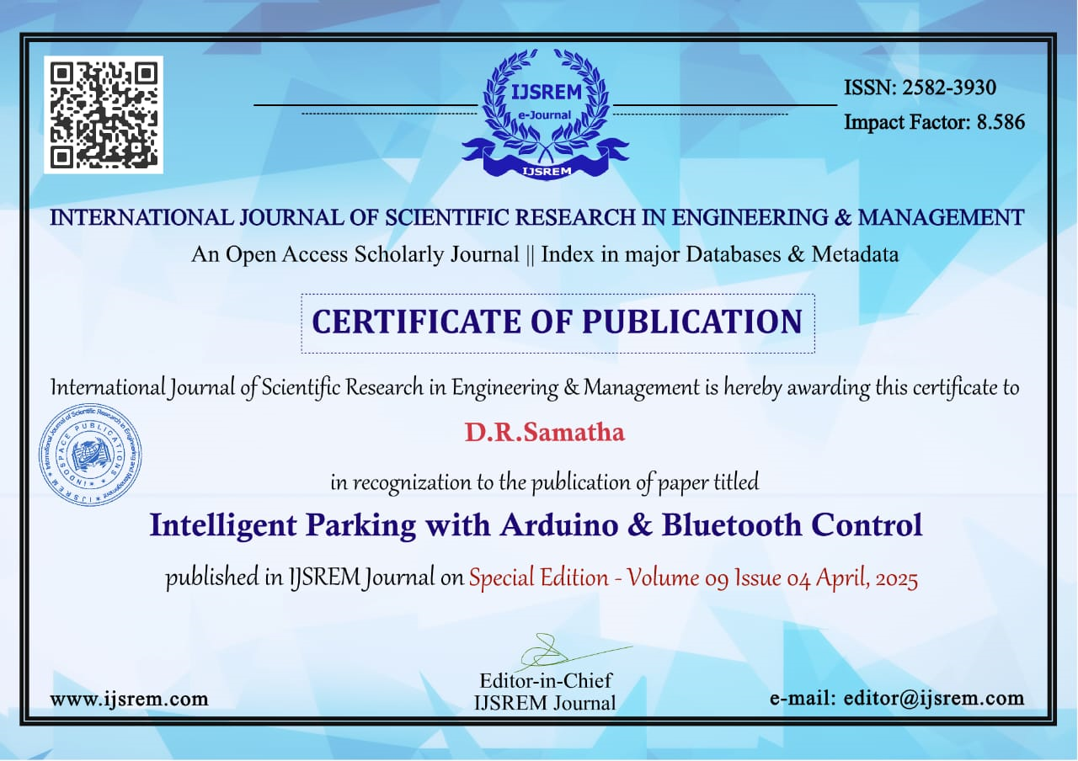

Slide 34


Slide 35


Slide 36


